Slide 1

Computer System Servicing

Slide 2


Slide 3
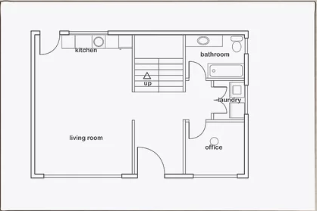
House Blue print

Slide 4
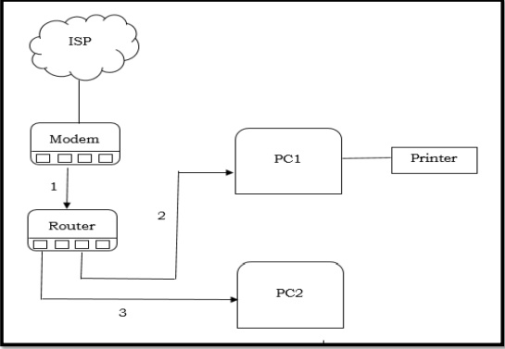
Network Layout

Slide 5
IP Address
An Internet Protocol (IP) address is a unique numerical identifier for every device or network that connects to the internet.

Slide 6
Static IP Address
A static IP address is simply an address that doesn't change. Once your device is assigned a static IP address, that number typically stays the same until the device is decommissioned or your network architecture changes.

Slide 7
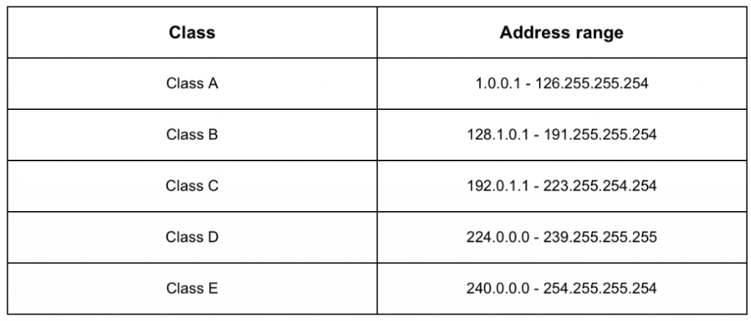
Classes of IP Address

Slide 8
Dynamic IP Address
A dynamic IP address is an IP address that an ISP lets you use temporarily. If a dynamic address is not in use, it can be automatically assigned to a different device. Dynamic IP addresses are assigned using either DHCP.

Slide 9
Subnet Mask
A subnet mask is defined as a 32-bit address that segregates an IP address into network bits that identify the network and host bits that identify the host device operating on that network.

Slide 10
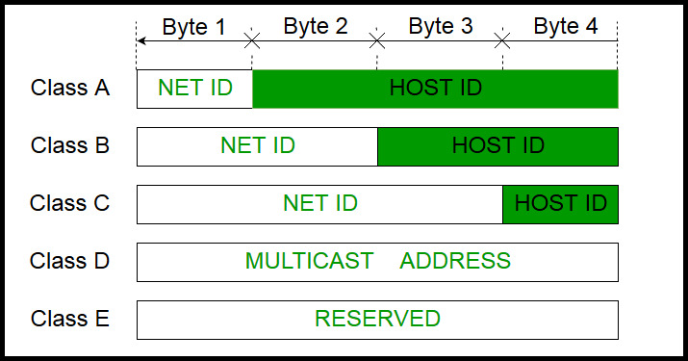
Network ID and Host ID

Slide 11
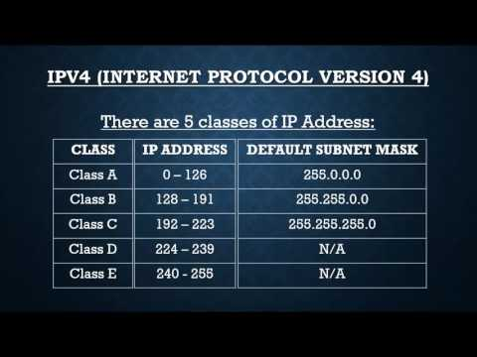
Subnet

Slide 12
THANK YOU!!!

